Slide 1


<Zhilin Zhao>
<2024.02>

Slide 2

Outline
Executive Summary
Introduction
Methodology
Results
Conclusion
Appendix

Slide 3
Executive Summary
Summary of methodologies
Data Collection with SpaceX REST API and Web Scraping
Exploratory Data Analysis with SQL and Visualization
Data Wrangling
Interactive Visual Analytics with Folium and Plotly Dashboard
Machine Learning Prediction
Summary of all results
The SVM, KNN, and Logistic Regression models are the best in terms of prediction accuracy for this dataset.

Slide 4
Introduction
Project background and context
SpaceX advertises Falcon 9 rocket launches on its website with a cost of 62 million dollars; other providers cost upward of 165 million dollars each, much of the savings is because SpaceX can reuse the first stage. Therefore if we can determine if the first stage will land, we can determine the cost of a launch. This information can be used if an alternate company wants to bid against SpaceX for a rocket launch.
Problems you want to find answers
Can we predict if the Falcon 9 first stage will land successfully?

Slide 5

Section 1

Slide 6
Methodology
Executive Summary
Data collection methodology:
SpaceX RESR API
Webscraping with related wiki pages
Perform data wrangling
Filling missing value with `mean`; Converting outcomes into Training Labels with `1` means the booster successfully landed `0` means it was unsuccessful
Perform exploratory data analysis (EDA) using visualization and SQL
Perform interactive visual analytics using Folium and Plotly Dash
Perform predictive analysis using classification models
LR, KNN, SVM, DT models were built and evaluated for the best model

Slide 7
Data Collection
SpaceX API.
WebScraping
Use SpaceX REST API
Parse Response in JSON
Normalize JSON to DataFrame
Data wrangling
Get URL
Parse html Response with BeautifulSoup
Parse table to DataFrame
Data wrangling

Slide 8
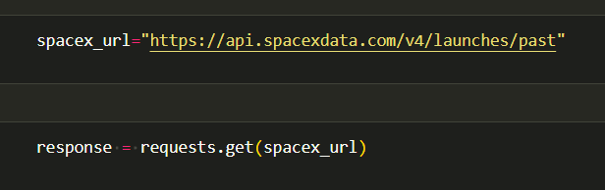
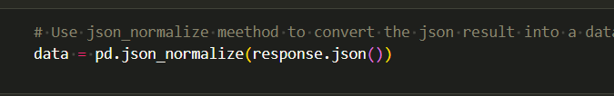
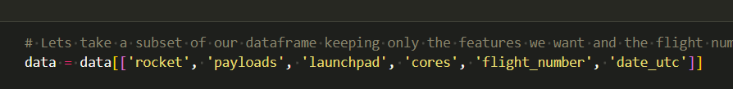
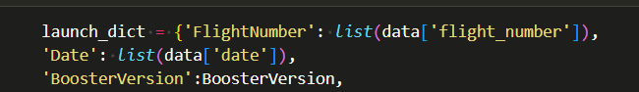
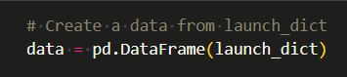
Data Collection – SpaceX API
https://github.com/ringo-alin/IBE-DataScience-Assignments/blob/main/Course%2010/jupyter-labs-spacex-data-collection-api.ipynb

Slide 9
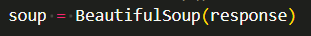
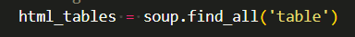
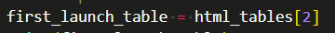
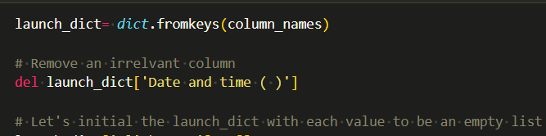
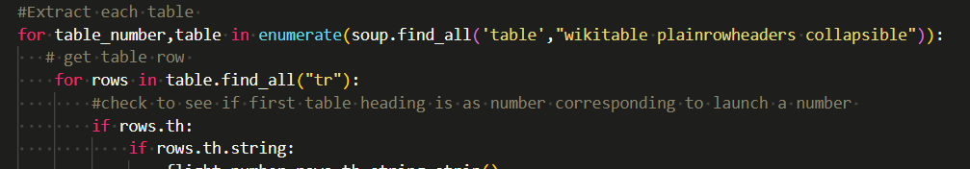
Data Collection - Scraping
https://github.com/ringo-alin/IBE-DataScience-Assignments/blob/main/Course%2010/jupyter-labs-webscraping.ipynb

Slide 10
Data Wrangling
Check null values
Calculate the number of launches, sites, orbits, outcomes
Fill null values
https://github.com/ringo-alin/IBE-DataScience-Assignments/blob/main/Course%2010/labs-jupyter-spacex-Data%20wrangling.ipynb

Slide 11
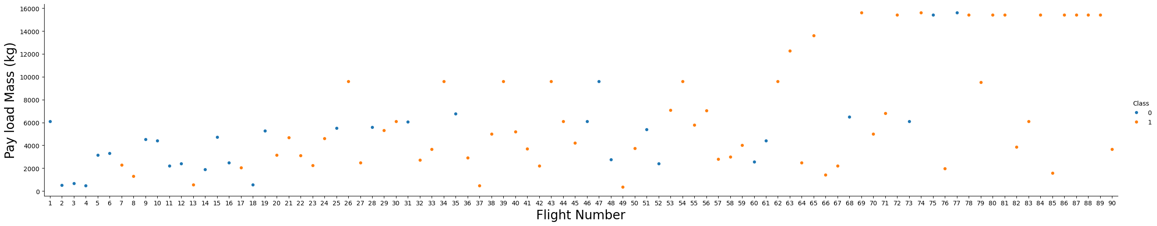
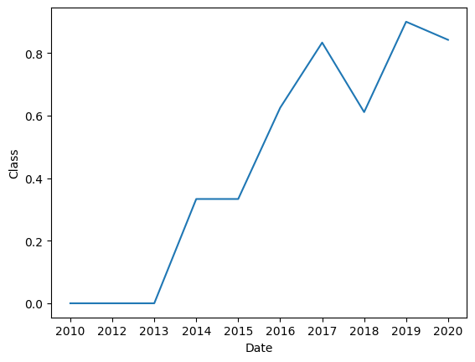
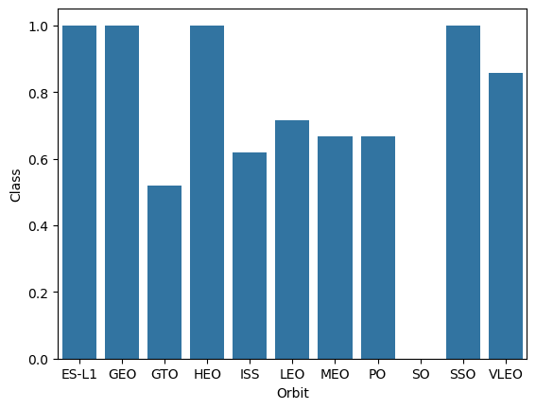
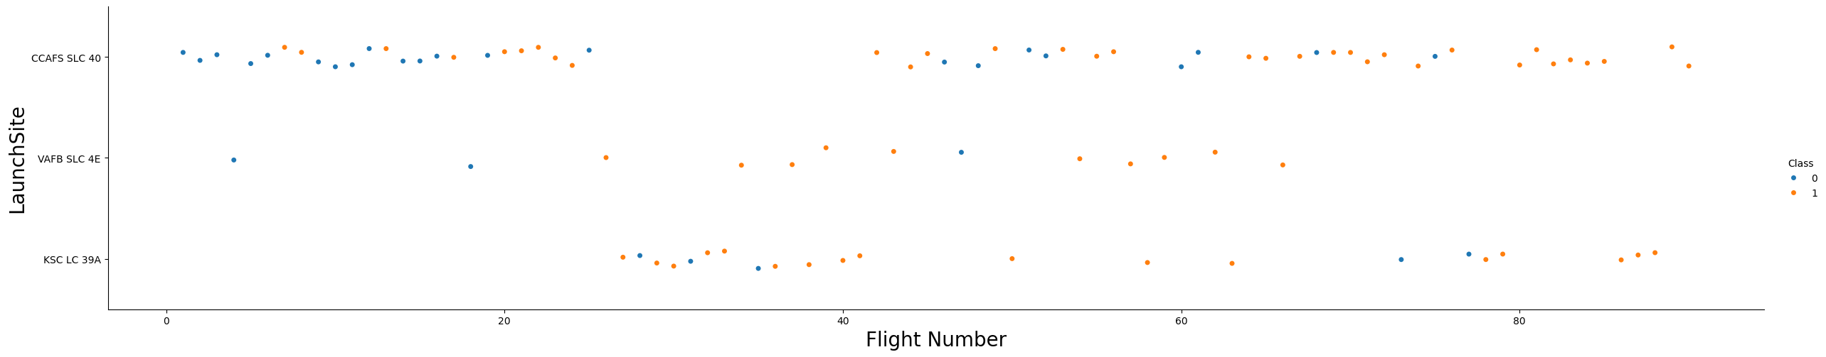
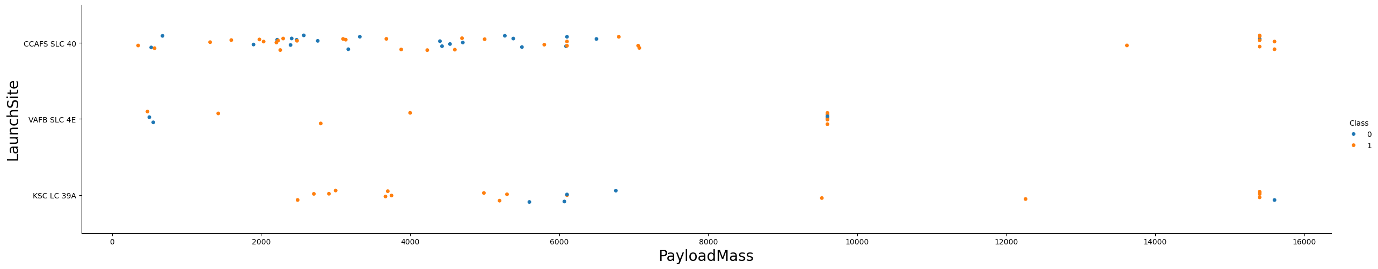
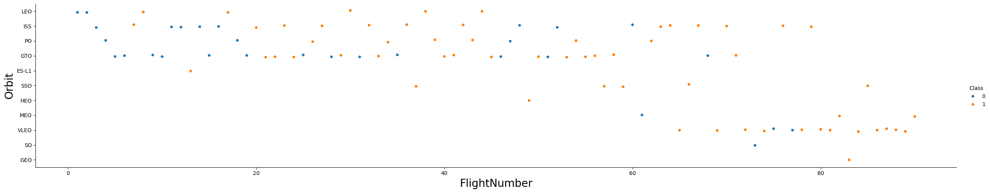
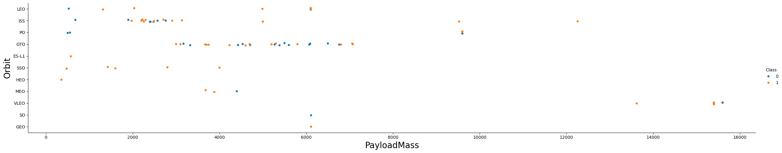
EDA with Data Visualization
https://github.com/ringo-alin/IBE-DataScience-Assignments/blob/main/Course%2010/jupyter-labs-eda-dataviz.ipynb.jupyterlite.ipynb

Slide 12
EDA with SQL
SQL queries
select distinct(Launch_Site) from SPACEXTABLE
select Launch_Site from SPACEXTABLE limit 5
select distinct(Landing_Outcome) from SPACEXTABLE
select sum(PAYLOAD_MASS__KG_) from SPACEXTABLE where Customer == "NASA (CRS)“
select avg(PAYLOAD_MASS__KG_) from SPACEXTABLE where Booster_Version == "F9 v1.1“
select min(Date) from SPACEXTABLE where Landing_Outcome=='Success (ground pad)’
select Booster_Version from SPACEXTABLE where (PAYLOAD_MASS__KG_ > 4000) and (PAYLOAD_MASS__KG_ < 6000) and (Mission_Outcome == "Success")
select Mission_Outcome, count(*) from SPACEXTABLE group by Mission_Outcome
https://github.com/ringo-alin/IBE-DataScience-Assignments/blob/main/Course%2010/jupyter-labs-eda-sql-coursera_sqllite.ipynb

Slide 13
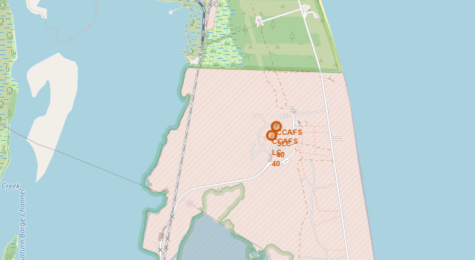
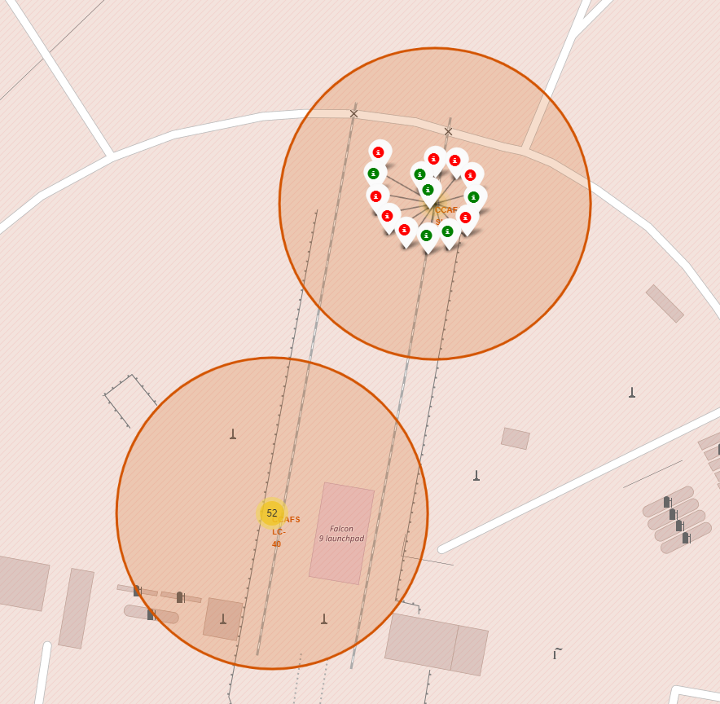
Build an Interactive Map with Folium
https://github.com/ringo-alin/IBE-DataScience-Assignments/blob/main/Course%2010/lab_jupyter_launch_site_location.jupyterlite.ipynb

Slide 14
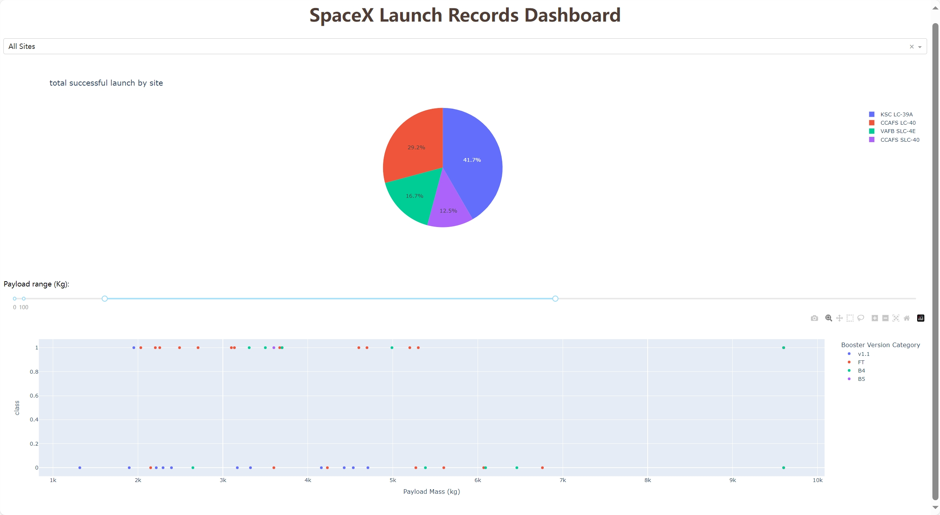
Build a Dashboard with Plotly Dash
https://github.com/ringo-alin/IBE-DataScience-Assignments/blob/main/Course%2010/spacex_dash_app.py

Slide 15
Predictive Analysis (Classification)
https://github.com/ringo-alin/IBE-DataScience-Assignments/blob/main/Course%2010/SpaceX_Machine_Learning_Prediction_Part_5.jupyterlite.ipynb
Preprocessing
Train test spliting
Hypertuning （GridSearch） on training set
Evaluating on test set

Slide 16
Results
Accuracy on test set
Model | Accuracy
Logistic regression | 0.83
SVM | 0.83
Decision Tree | 0.78
KNN | 0.83

Slide 17

Section 2

Slide 18
Flight Number vs. Launch Site
As the flight number increases, the first stage is more likely to land successfully

Slide 19
Payload vs. Launch Site
the VAFB-SLC launchsite there are no rockets launched for heavypayload mass(greater than 10000).

Slide 20
Success Rate vs. Orbit Type
ES-L1, GEO, HEO, SSO have high success rate

Slide 21
Flight Number vs. Orbit Type
in the LEO orbit the Success appears related to the number of flights; on the other hand, there seems to be no relationship between flight number when in GTO orbit.

Slide 22
Payload vs. Orbit Type
With heavy payloads the successful landing or positive landing rate are more for Polar,LEO and ISS.
However for GTO we cannot distinguish this well as both positive landing rate and negative landing(unsuccessful mission) are both there here.

Slide 23
Launch Success Yearly Trend
the sucess rate since 2013 kept increasing till 2020

Slide 24
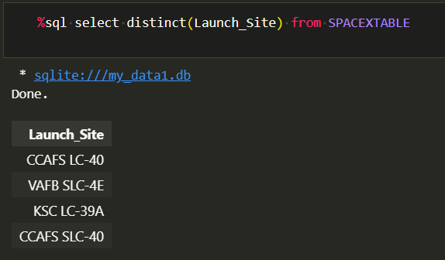
All Launch Site Names
Find the names of the unique launch sites

Slide 25
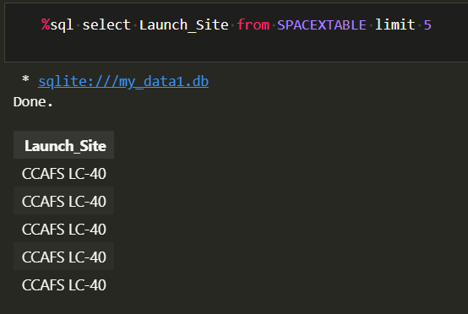
Launch Site Names Begin with 'CCA'
Find 5 records where launch sites begin with `CCA`

Slide 26
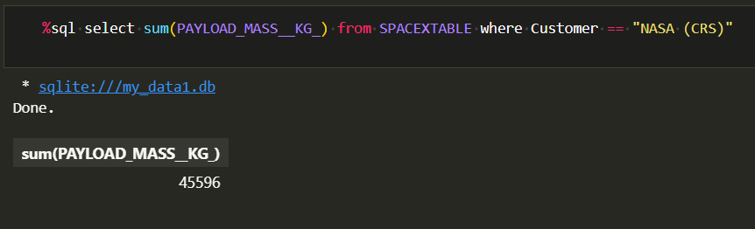
Total Payload Mass
Calculate the total payload carried by boosters from NASA

Slide 27
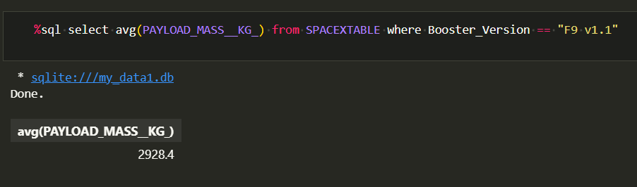
Average Payload Mass by F9 v1.1
Calculate the average payload mass carried by booster version F9 v1.1

Slide 28
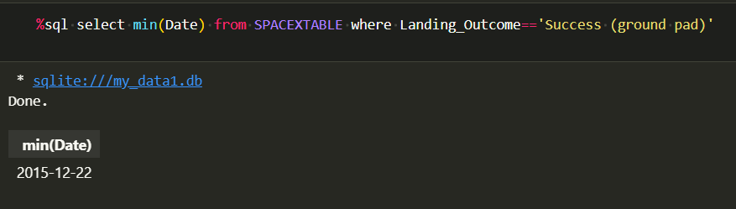
First Successful Ground Landing Date
Find the dates of the first successful landing outcome on ground pad

Slide 29
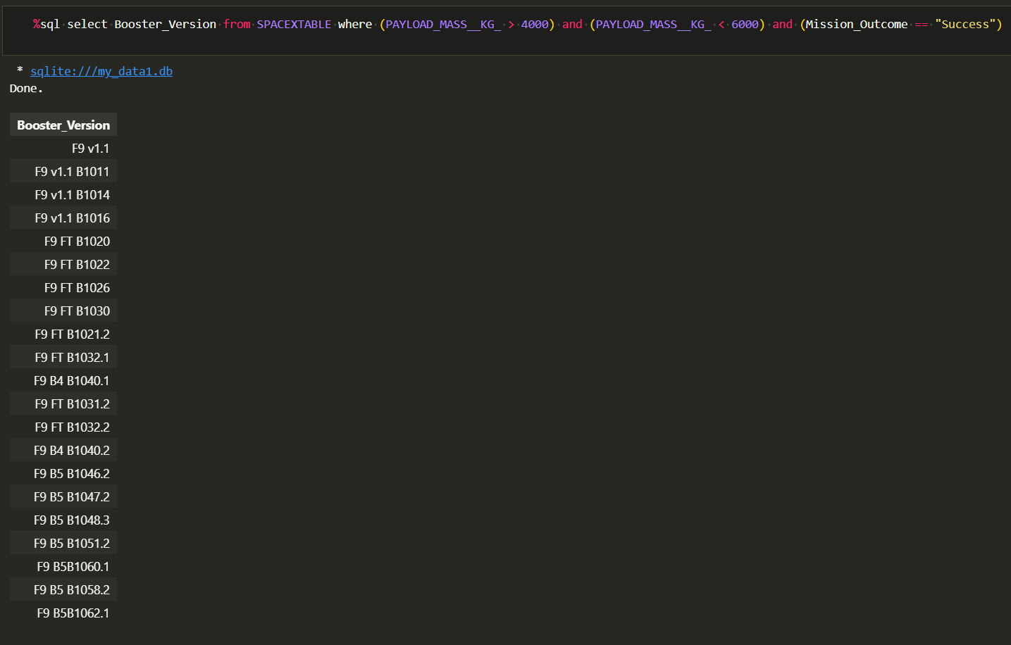
Successful Drone Ship Landing with Payload between 4000 and 6000
List the names of boosters which have successfully landed on drone ship and had payload mass greater than 4000 but less than 6000

Slide 30
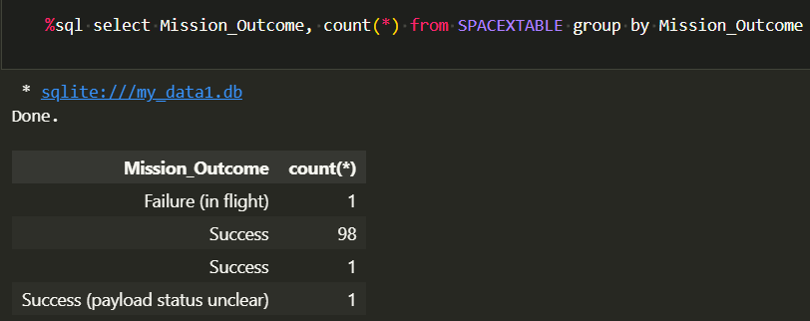
Total Number of Successful and Failure Mission Outcomes
Calculate the total number of successful and failure mission outcomes

Slide 31
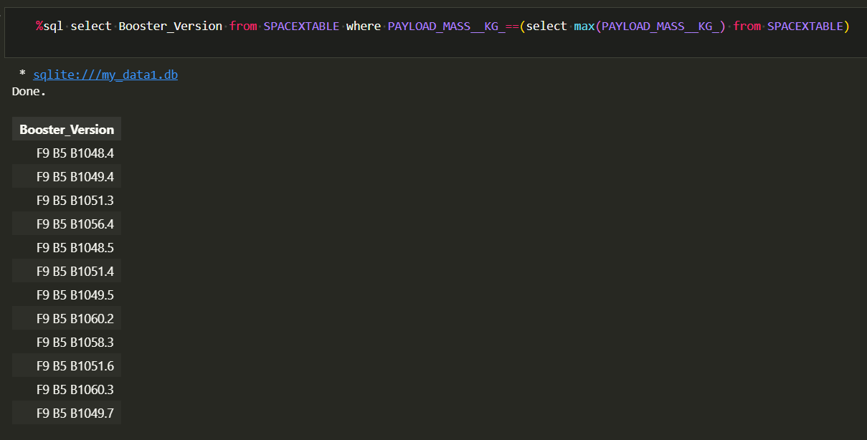
Boosters Carried Maximum Payload
List the names of the booster which have carried the maximum payload mass

Slide 32
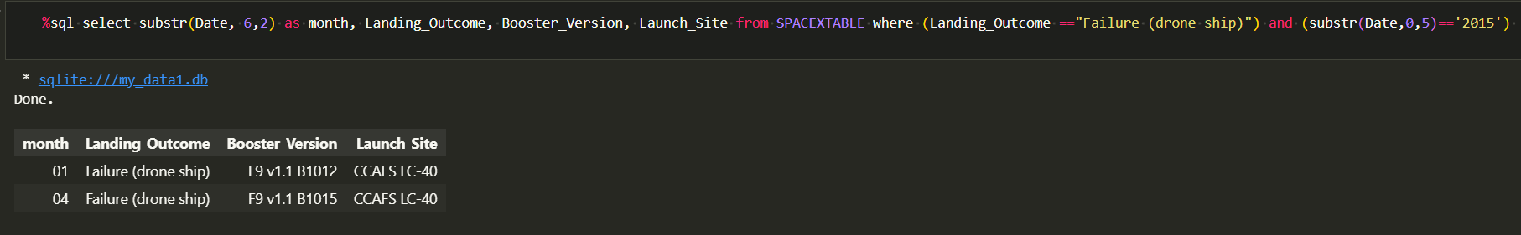
2015 Launch Records
List the failed landing_outcomes in drone ship, their booster versions, and launch site names for in year 2015

Slide 33
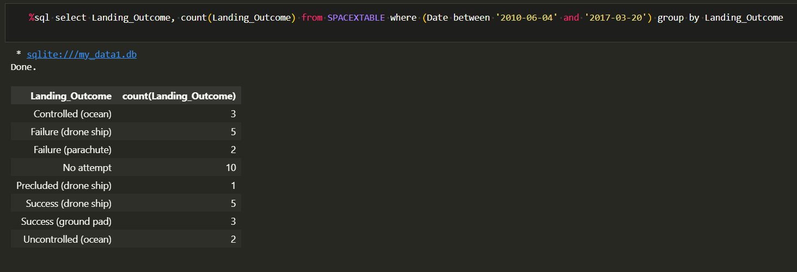
Rank Landing Outcomes Between 2010-06-04 and 2017-03-20
Rank the count of landing outcomes (such as Failure (drone ship) or Success (ground pad)) between the date 2010-06-04 and 2017-03-20, in descending order
Present your query result with a short explanation here

Slide 34

Section 3

Slide 35
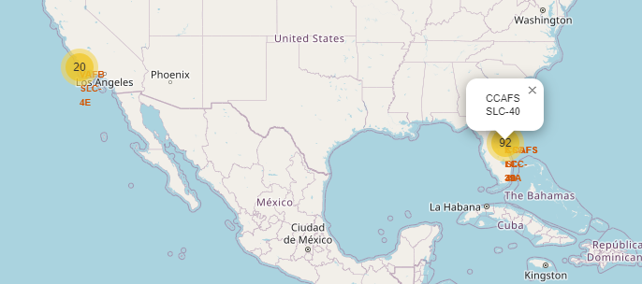
Global location view

Slide 36
Zoom in

Slide 37
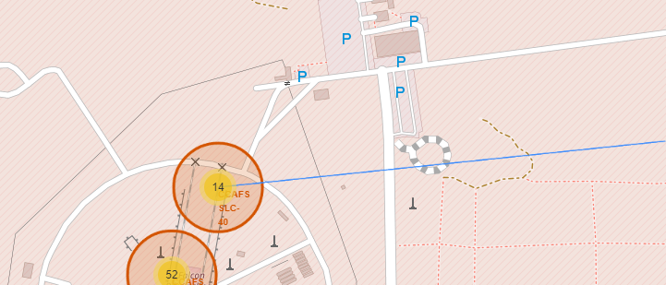
Distance

Slide 38

Section 4

Slide 39
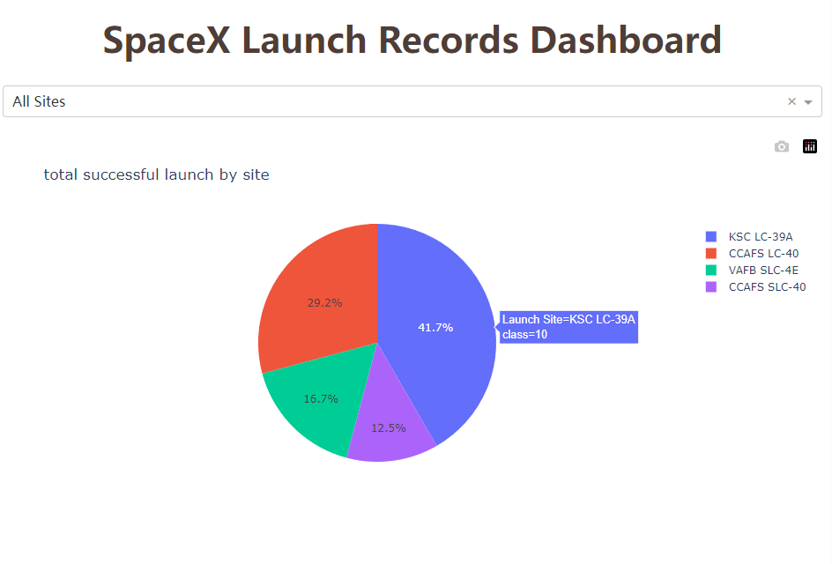
Launch success count for all sites

Slide 40
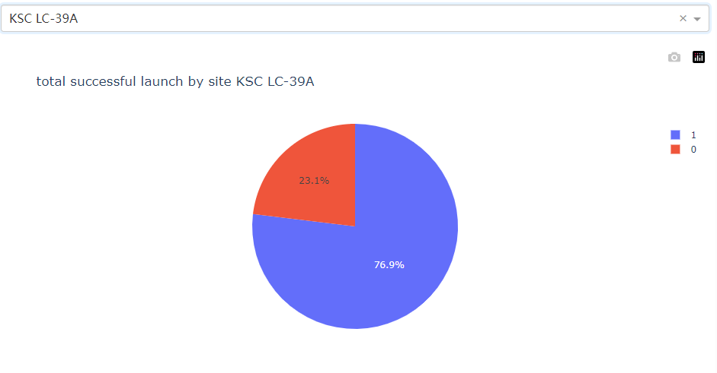
Success rate by site

Slide 41
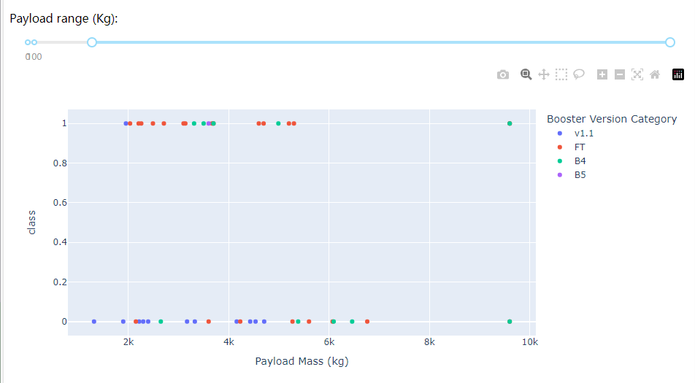
Payload vs launch outcome

Slide 42

Section 5

Slide 43
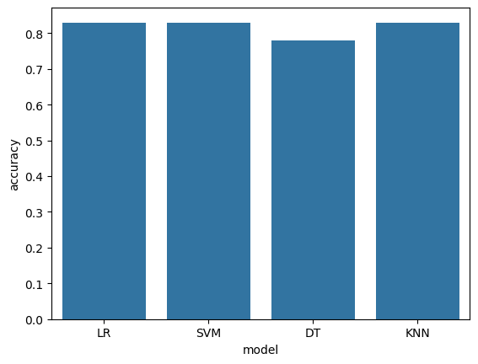
Classification Accuracy

Slide 44

Confusion Matrix
the confusion matrix of the best performing model

Slide 45
Conclusions
The SVM, KNN, and Logistic Regression models are the best in terms of prediction accuracy for this dataset.

Slide 46


